Slide 1
Advisor Name:
Grand Canyon University
The Utilization of Artificial Intelligence to Diagnose Tumors
Wilson B. Peguero Rosario
Context & Background
Use deep learning algorithms to classify DICOM images of possible tumors as benign or malignant
Initial application will be based on retrospective mammograms.
Metadata available will be used to assist the algorithm.
Research Question
Can machine learning algorithms be used to mitigate the demand for radiologists?
We would like to acknowledge ....

Slide 2


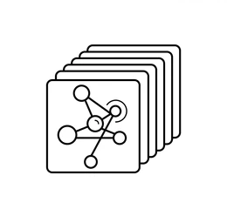
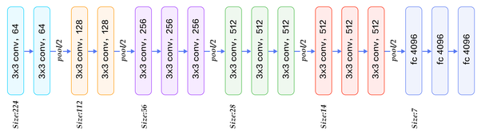

Training Model
DICOM Data Storage (PACS system)
Data Pipeline
Labeled Data for Training
Using the Finalized Model
Results
Finalized Model

